Slide 1
Converting P&IDs into AI-Friendly Structured Text
A prompt suite for extracting structured data from piping & instrumentation diagrams
Edward Marszal, P.E. · Kenexis Consulting Corporation
Purdue P2SAC Spring Conference · April 2026

Slide 2
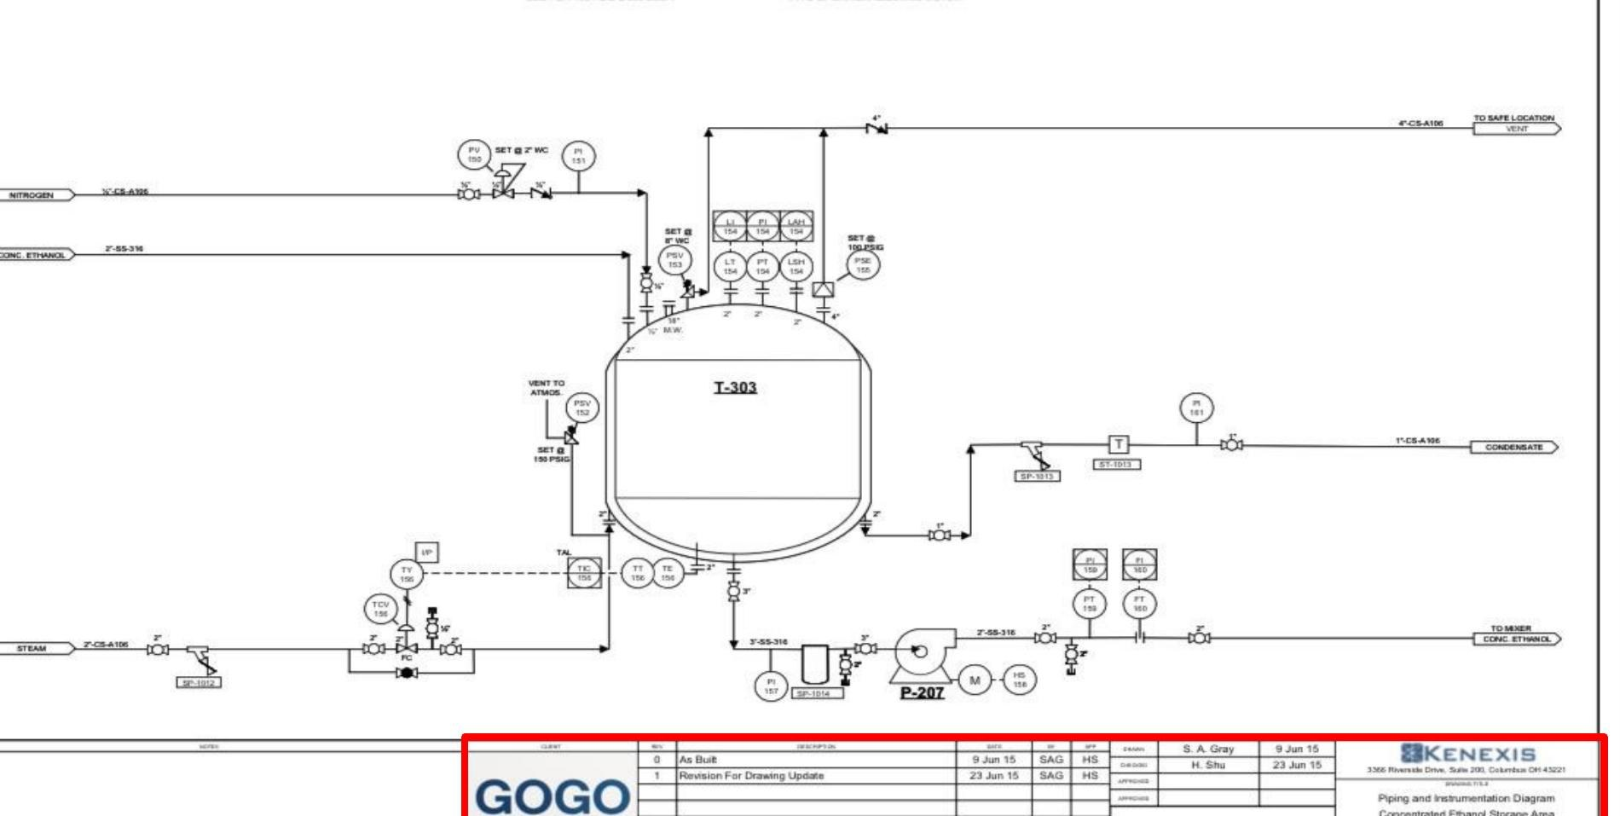
The problem: LLMs are text engines; P&IDs are images
Reading a P&ID as pixels is the wrong job for an LLM.
Forced to interpret an engineering drawing visually, LLMs:
Miss small or stylized equipment
Invent connections that aren't on the page
Give different answers across runs and across models
Cannot easily be audited or version-controlled

Slide 3
Why this matters
HAZOP assistance
Reason node-by-node about equipment and protections.
LOPA & SIL verification
Reason about IPLs and SIFs from the actual diagram.
P&ID
AI-readable representation
SRS authoring
Auto-draft SRS narratives from structured data.
Asset Q&A
Query the P&ID in natural language.

Slide 4
The approach in one diagram
Solve the representation step once — every downstream workflow inherits a clean input.
P&ID image
PDF or scan
Prompt suite
5 modules
Structured text
DEXPI XML today
Markdown next
Consumed by HAZOP, LOPA, SIL, SRS, and other downstream AI workflows

Slide 5
First attempt: DEXPI
Why we picked DEXPI for v1
Industry-recognized standard for plant data exchange
Schema covers vessels, pumps, valves, instruments, piping
XML output is unambiguous and validatable
Gives the LLM a clear schema target — reduces invented field names
DEXPI
Data Exchange in the
Process Industry
─
Standardized XML schema
for plant and P&ID data

Slide 6
But DEXPI has friction with LLMs
Good for engineers and tools
Rough for LLM consumption
Strict schema → unambiguous semantics
Validatable against XML Scheme Definition
Lossless representation of plant data
Interoperable with engineering software
XML is verbose — high token cost
Heavy nesting — hard to track
Closing tags easy to mis-emit
Rare in LLM training data vs. markdown
This finding will drive the future-work pivot to markdown.

Slide 7
Modular prompt architecture
1
2
3
4
5
Metadata
Title block
Equipment
Vessels,
pumps
Valves
Check, gate,
globe
Piping
Line tags
and sizes
Connections
Inter-page
tie-ins
Done
In progress
In progress
Pending
Pending
Each module isolates one slice of the P&ID — develop, test, and stress separately.

Slide 8
Prompt design principles
Persona
Explicit search logic
Anchor the model as a meticulous DEXPI process engineer. Sets the bar for precision.
Tell the LLM where to look on the drawing — title block, revision log, equipment tag.
Exclusion rules
Do not invent data
Spell out what NOT to grab — Drawn By is not Responsible Engineer; Owner is not Department.
Strict null rule. Empty stays empty. Better to miss than to hallucinate.

Slide 9
Metadata prompt — the easiest module
Targets the title block
Bottom-right corner of the drawing — predictable, consistent location.
Plant Model
Plant name, project number, default units
Drawing
Number, title, sub-title, revision, date
Responsible engineer and department
Drafting metadata: drafter, approver, descriptions
Why first?
Predictable region. Consistent fields.
A fast win that gave us the prompt template — exclusion rules, null rules, format normalization.

Slide 10
Metadata prompt — example output
<?xml version="1.0" encoding="UTF-8"?>
<PlantModel
PlantName=""
ProjectNumber=""
DefaultUnits="Imperial">
<Drawing
DrawingNumber="D-1151-006"
DrawingTitle="Piping and
Instrumentation Diagram"
DrawingSubTitle=
"Concentrated Ethanol..."
Revision="1"
Date="2015-06-23"
ResponsibleEngineer="H. Shu"
ResponsibleDepartmentName=
"KENEXIS">
</Drawing>
</PlantModel>
D-1151-006 Rev 1 · Concentrated Ethanol Storage Area

Slide 11
Equipment prompt — DEXPI-aligned taxonomy
Mechanical & rotating
Heat & mass transfer
Specialized & solids
Pumps and compressors
Drivers (motor, engine, generator)
Centrifuges and separators
Heat exchangers, coolers
Boilers and burners
Columns, vessels, reactors
Mixers and agglomerators
Crushers, mills, dryers
Package and utility units
Plus instruments, internals (impellers, tube bundles), and piping accessories.

Slide 12
Equipment prompt — example output
<EquipmentComponents>
<Component class="StorageTank">
<Tag>T-303</Tag>
<Description>
CONCENTRATED ETHANOL...
</Description>
<DesignParameters>
<DesignPressure>100 PSIG
<DesignTemperature>350°F
<Capacity>10000 GAL
</DesignParameters>
<MechanicalData>
<Dimensions>11'8" × 13'4"
<MaterialOfConstruction>
316 SS
</MechanicalData>
</Component>
</EquipmentComponents>
Tag T-303 · Concentrated Ethanol Storage Tank

Slide 13
Valves prompt — in progress
Targets
Isolation valves: ball, check, gate, globe
Safety devices: rupture discs, PSVs, breather valves
Accessories: traps, strainers, in-line mixers
Fittings: reducers, tees, blind flanges
What's harder than equipment
Symbols are small, dense, and clustered
Can’t rely on text in PDF
Set-pressure tags must be associated correctly
Status
Identification working on clean diagrams.
Tag and accessory association is the active failure mode.

Slide 14
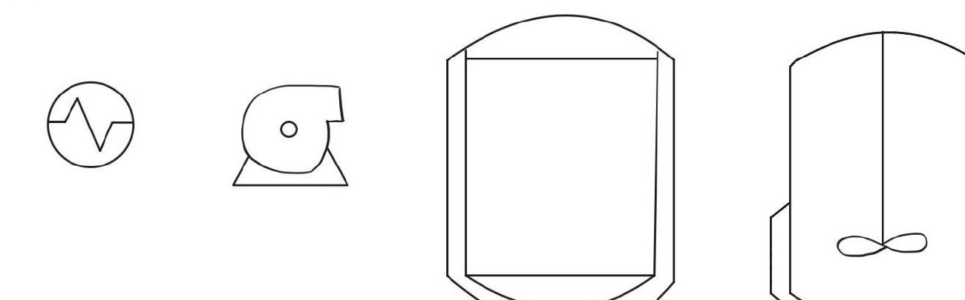
Validation — what we tested
Trial 1: Hand-drawn equipment
Trial 2: Visual-only on a real P&ID
Result: partially successful
Result: successful
Tanks and pumps recognized. Stylized agitators and unusual symbols missed.
Title block, equipment list, and most piping captured on a clean drawing.

Slide 15
Same prompt, different LLMs, different answers
Identical prompts. Multiple frontier models. Outputs varied.
A robust prompt has to be tested against more than one engine.
Identification varies
Some models miss small instrumentation; others over-call valves.
Format compliance varies
Clean XML from one model is malformed from another.
"Invented" content varies
Hallucinated equipment differs by model — a key safety risk.
Stability varies
Same model + same prompt + same drawing → different runs differ.

Slide 16
Results scorecard
Module
Status
Notes
Metadata
Title block extraction reliable on clean drawings.
Strong
Equipment
Major equipment recognized; specialty equipment is the gap.
Working
Valves
ID working; tag and accessory association still fragile.
In progress
Piping
Line tagging and segment topology — next phase.
Not started
Inter-page
Cross-sheet continuation tags — needed for full plant graph.
Not started

Slide 17
False negatives beat false positives
Preferred
Avoided
80% true positive
with
20% false negative
Missed equipment is recoverable. Reviewer can spot the gap.
90% true positive
with
10% false positive
Invented equipment is dangerous — nothing in the drawing to disprove it.
In safety analysis: missing data is a workflow problem; invented data is a hazard.

Slide 18
Future direction: pivot from DEXPI to Markdown
DEXPI XML
v1 representation
Markdown
v2 representation
Native LLM format
Markdown is the de-facto LLM artifact format.
Lower token cost
Compact, no closing tags to track.
Easier to generate
Closer to LLM training distribution.
Trivial to consume
Tools, pipelines, and humans all read it.

Slide 19
Remaining work
Build out the prompt suite
Stress test against harder P&IDs
Pipe segments
Line tags, sizes, specs, and routing.
Inter-page connections
Off-page tie-ins — turn many sheets into one plant graph.
Instrumentation loops
Tie sensors, controllers, and final elements into named loops.
Low-quality scans
Faded lines, skewed pages, JPEG artifacts.
Dense, congested drawings
Process units with hundreds of overlapping tags.
Non-standard symbol sets
Older drawings or proprietary symbol libraries.

Slide 20
Acknowledgments · Q&A
Thank you
Questions and discussion welcome
Capstone team
Isabella Franzini
Michael Fisher
Purdue ChE Davidson School
Project Manager
Dr. William R. Clark
Purdue ChE PMP
Host
Purdue Process Safety
and Assurance Center
Edward Marszal, P.E. · edward.marszal@kenexis.com · Kenexis Consulting

